Slide 1
A Split Analysis of the Affected experiencers introducer “gei” in Mandarin
Peking University Wang Siyu

Slide 2
“gei” as a co-verb (or preposition) introducing non core arguments:
(1) Zhangsan gei Lisi kao le dangao. (benefactive)
Zhangsan give Lisi bake-Asp cake
Zhangsan baked a cake for Lisi.
(2) Zhangsan gei Lisi guyi dao luan. (malefactive)
Zhangsan give Lisi intentionally make troubles
Zhangsan made trouble for Lisi intentionally.
Notes:
In various theories about “gei”, this affected experiencers introducer “gei” is analyzed as a united item, verb or prep. However, there are some asymmetries between the 2 gei, and we want to argue that they are actually 2 different items.

Slide 3
1. beneficiary and maleficiary
Van Valin and LaPolla (1997):
a. recipient benefactives: the beneficiary is the (intended) possessor/ recipient;
Zhangsan gei Lisi kao yi-kuai dangao.
b. plain benefactives: the beneficiary undergoes some general benefit, physically or mentally, such as being serviced, helped ect.
Zhangsan gei Lisi nianshu.
c. deputative benefactives: the agent is the proxy, substituting for the beneficiary conducting the action.
Zhangsan gei Lisi zuo zuoye.
Notes:
There are 3 branches of benefactive “gei”, the first is
倒茶 做菜
做翻译 洗衣服
They are superficially similar， however, wee have some syntactic approach to distinguish them:
Dative vatiant :Gei NP can be post verbal
Wei
ti

Slide 4
a. source maleficiary : the maleficiary is an implied source of the theme.
Zhangsan gei Lisi nonghuai le shouji.
Zhangsan give Lisi broken- Asp cell phone.
Zhangsan broken the cell phone for Lisi.
b. plain maleficiary: the maleficiary undergoes some general miserables, unsatisfaction, being harmed or being negatively influenced.
Zhangsan gei laoshi zai keshang daoluan.
Zhangsan give teacher on class make trouble.
Zhangsan made troubles on the teachers on the class.
Notes:
in order to make it paralle, we classify the affected “gei” constructions into 2 subtypes:

Slide 5
(1). Preposition dative variant:
2. Asymmetry between the 2 “gei”:
(3) Zhangsan kaole yikuai dangao gei mama
Zhangsan bake-Asp one-Cl cake give mother
Zhangsan baked a cake for his mother.
(4)*Zhangsan dapo le huaping gei mama.
Zhangsan break-Asp vase socre give mother
Zhangsan got 0 score which for his mother.

Slide 6
(2). Topicalization:
(5) gei Lisi, Zhangsan maile yihu jiu.
give Lisi, Zhangsan buy-Asp one-CL wine
For Lisi, Zhangsan bought a bottle of wine
(6)*gei Lisi, Zhangsan heguangle yihu jiu.
give Lisi, Zhangsan drinkover-Asp one-CL wine
Zhangsan drank over a bottle of wine onLisi.(Maybe because it is Lisi’s wine.)

Slide 7
The distinction in topicalization and prepositional dative indicates that benefactive “gei” is a preposition, “gei NP” as an adjunct can move freely. Whereas affected “gei” behaves more like a verb, which has a fixed projection in the syntactic structure and cannot be displaced easily.

Slide 8
(3). Interaction with “zenme”:
(7) Zhangsan zenme gei ni ba wuzi nongde yituanzao?
Zhangsan how give you BA room mess up?
*How does Zhangsan mess up the room for you?
How come Zhangsan mess up the room for you?
(8) Zhangsan zenme gei ni xiu che?
Zhangsan how give you fix car?
How does Zhangsan fix the car for you?
How come Zhangsan fix the car for you?
Notes:
In mandarin Chinese we have 2 zenme, with one asking for reason, the other one asking for manner and the first one projects higher than the second one, which has been proved in Tsai（2000）， here It indicates that benefactive gei can be merged lower than the manner “zenme” while the affected gei can only be merged higher than manner zenme but lower than reason zenme

Slide 9
（4）passivization
Mama bei Lisi chuang le dahuo.
Mama BEI Lisi make-Asp big trouble
The mother is suffered from Lisi’s making trouble
*Zongjingli bei Zhangsan kaiche.
Manager BEI Zhangsan drive car
Intended meaning： The manager was suffered from Lisi’s driving.

Slide 10
(5). Scope interaction with negation and A not A question:
(15)Zhangsan meiyou gei Lisi chuanghuo.
Zhangsan Neg give Lisi make trouble.
Zhangsan didn’t make trouble for Lisi.
(16)Zhangsan meiyou gei Lisi kaiche.
Zhangsan Neg give Lisi drive car.
Zhangsan didn’t drive at all.
Zhangsan drove the car, but not for Lisi.
(17) Zhangsan geimeigei Lisi chuanghuo ?
Zhangsan give-not-give Lisi make trouble ?
Did Zhangsan make trouble for Lisi?
(18) Zhangsan geimeigei Lisi kaiche ?
Zhangsan give-not-give Lisi drive car
Did Zhangsan drive car for Lisi?
Notes:
affected “gei” can escape away from the scope of negation, it cannot be negated alone. while benefactive “gei”can be negated alone
The contrast becomes more clear in A not A : although it is Gei mei gei undergoes morphological change, the question is asking whether zhangsan bring trouble whether he did something to being trouble. but in benefactive, we are asking whether the beneficiary is Lisi, whether it is lisi benefit from the driving event.

Slide 11
Bosse (2012): at issue meaning and not at issue meaning
Besides the truth condition (propositional meaning) derived by semantical composition, there is another tier of meaning which is not from compositionality but conventional implicature. It is called not at issue meaning.
Appositive is a kind of not at issue meaning:
We invited Louis, the king of France.
We didn’t invited Louis, the king of France.
Did you invited Louis, the king of France?
Not at issue meaning cannot be questioned and negated alone.
Notes:
How can we account for the difference?

Slide 12
Meaning of tier:
Affected “gei” and benefactive “gei” contribute to different tiers of meaning:
Benefactive: can be questioned or negated, contributes to at issue meaning.
Affected “gei”: cannot negated or questioned alone, which means that it contributes to some not at issue meaning.

Slide 13
A split analysis of “gei” :
Syntactically : category, projection height
Semantically: at issue meaning and not at issue meaning
What are the 2 “gei”s ?
Notes:
From above, we have ample evidence to say that the benefactive and affected “gei” are different:
Firstly, benefactive gei is more like a preposition, it is very flexible, undergo topicalization, a dative variant. But affected “gei” is not
Secondly, their interaction with zenme, subjective oriented adverb 故意 自愿, repetitive adverb 又，shows that they projects in different syntactic position. Affected gei is higher but benefactive gei is lower.
Semantically, affected “gei” cannot be questioned or negated alone, it contributes some not at issue meaning while benefactive gei only contributes to at issue meaning.
Last but not least, affected gei only select an accomplishment event as its complement, it requires a newly coming result as the source of the affected event, but the benefactive event doesn’t have the requirement.

Slide 14
Benefactive prep:
It only introduces an beneficiary into the original argument structure. It enriches the event by introducing an applicative argument.
Only encode at issue meaning.
John bought a book for Mary. ∃e. buy(e) & Thm(e)(a book) & Agt(e)(John) & benefaciary(e)(Mary)

Slide 15
The framework of Bosse(2012, 2015)
Affect head:
Affect head(AFF) involves an affected event argument. With this affected head, there is a new affected event. The spec of AFF introduces the affectee, and take its complement（an accomplishment event） as the source of the affected event.
Affected “gei” brings a new affected event. The sentence contains a bi-event structure: affected event and its source event.
It encodes some not at issue meaning.
Notes:
We can depict the difference between the 2 gei under the framework of Bosse.
In her theory, she argues that there is an affect head in syntax.

Slide 16
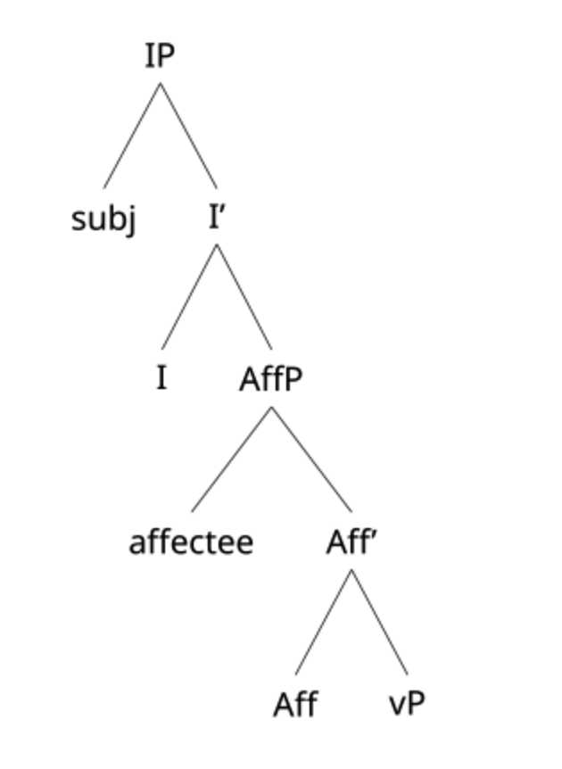
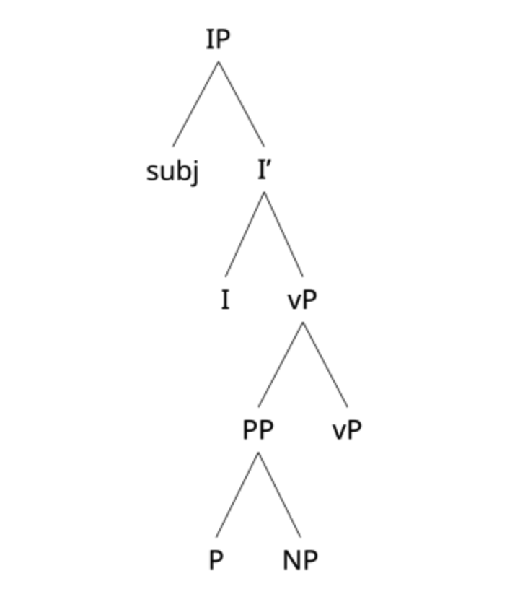
Syntactic structure:
Displacement
Zenme
Passivization

Slide 17
From affected “gei” to the outer affective “geiwo” :
Affected “geiNP” →“geiwo”: negative evaluation or direct imperative
The affected head “gei” projects in the CP layer
C_{mir} Eva（Juran）
Ta juran geiwo hele san ping jiu!
C_{imp}
Ni geiwo zhanzu!

Slide 18
Thank you!

